Slide 1
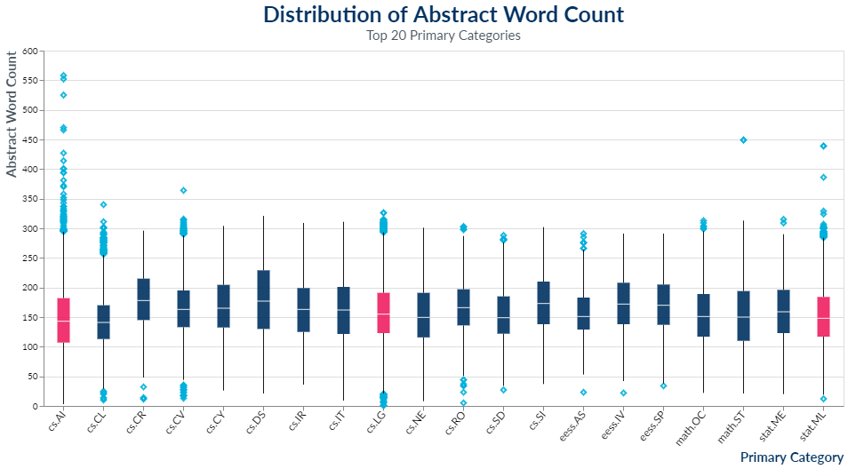
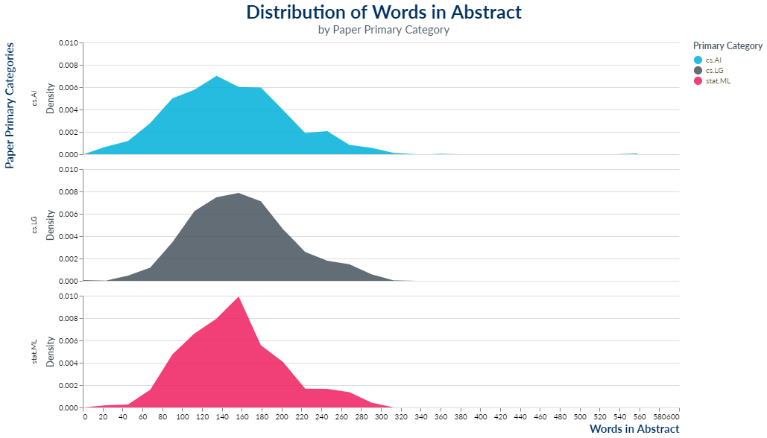
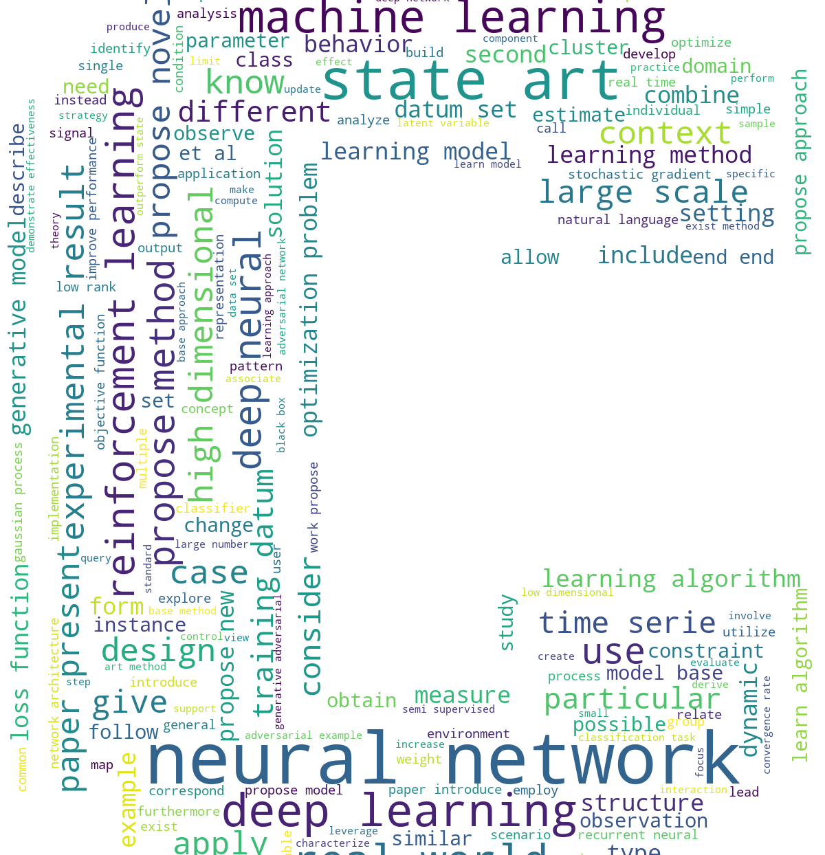
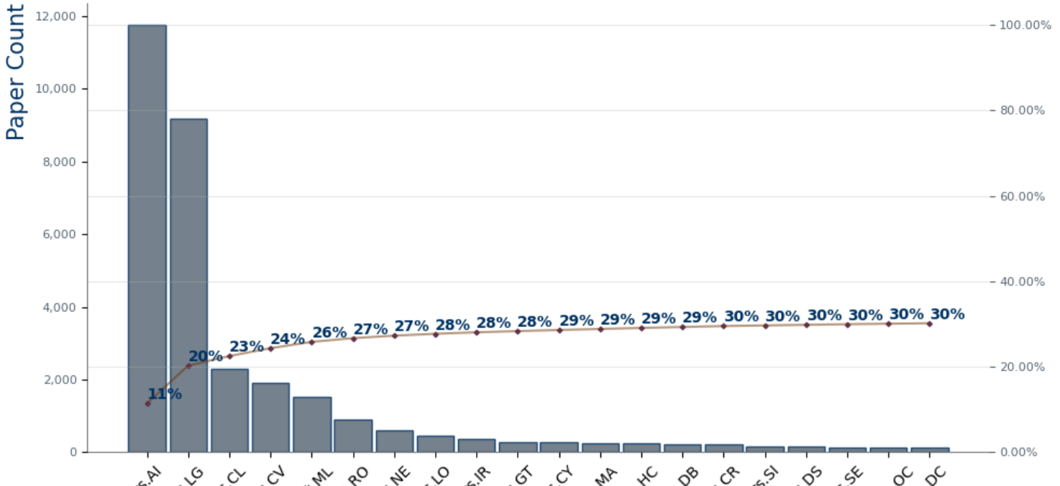
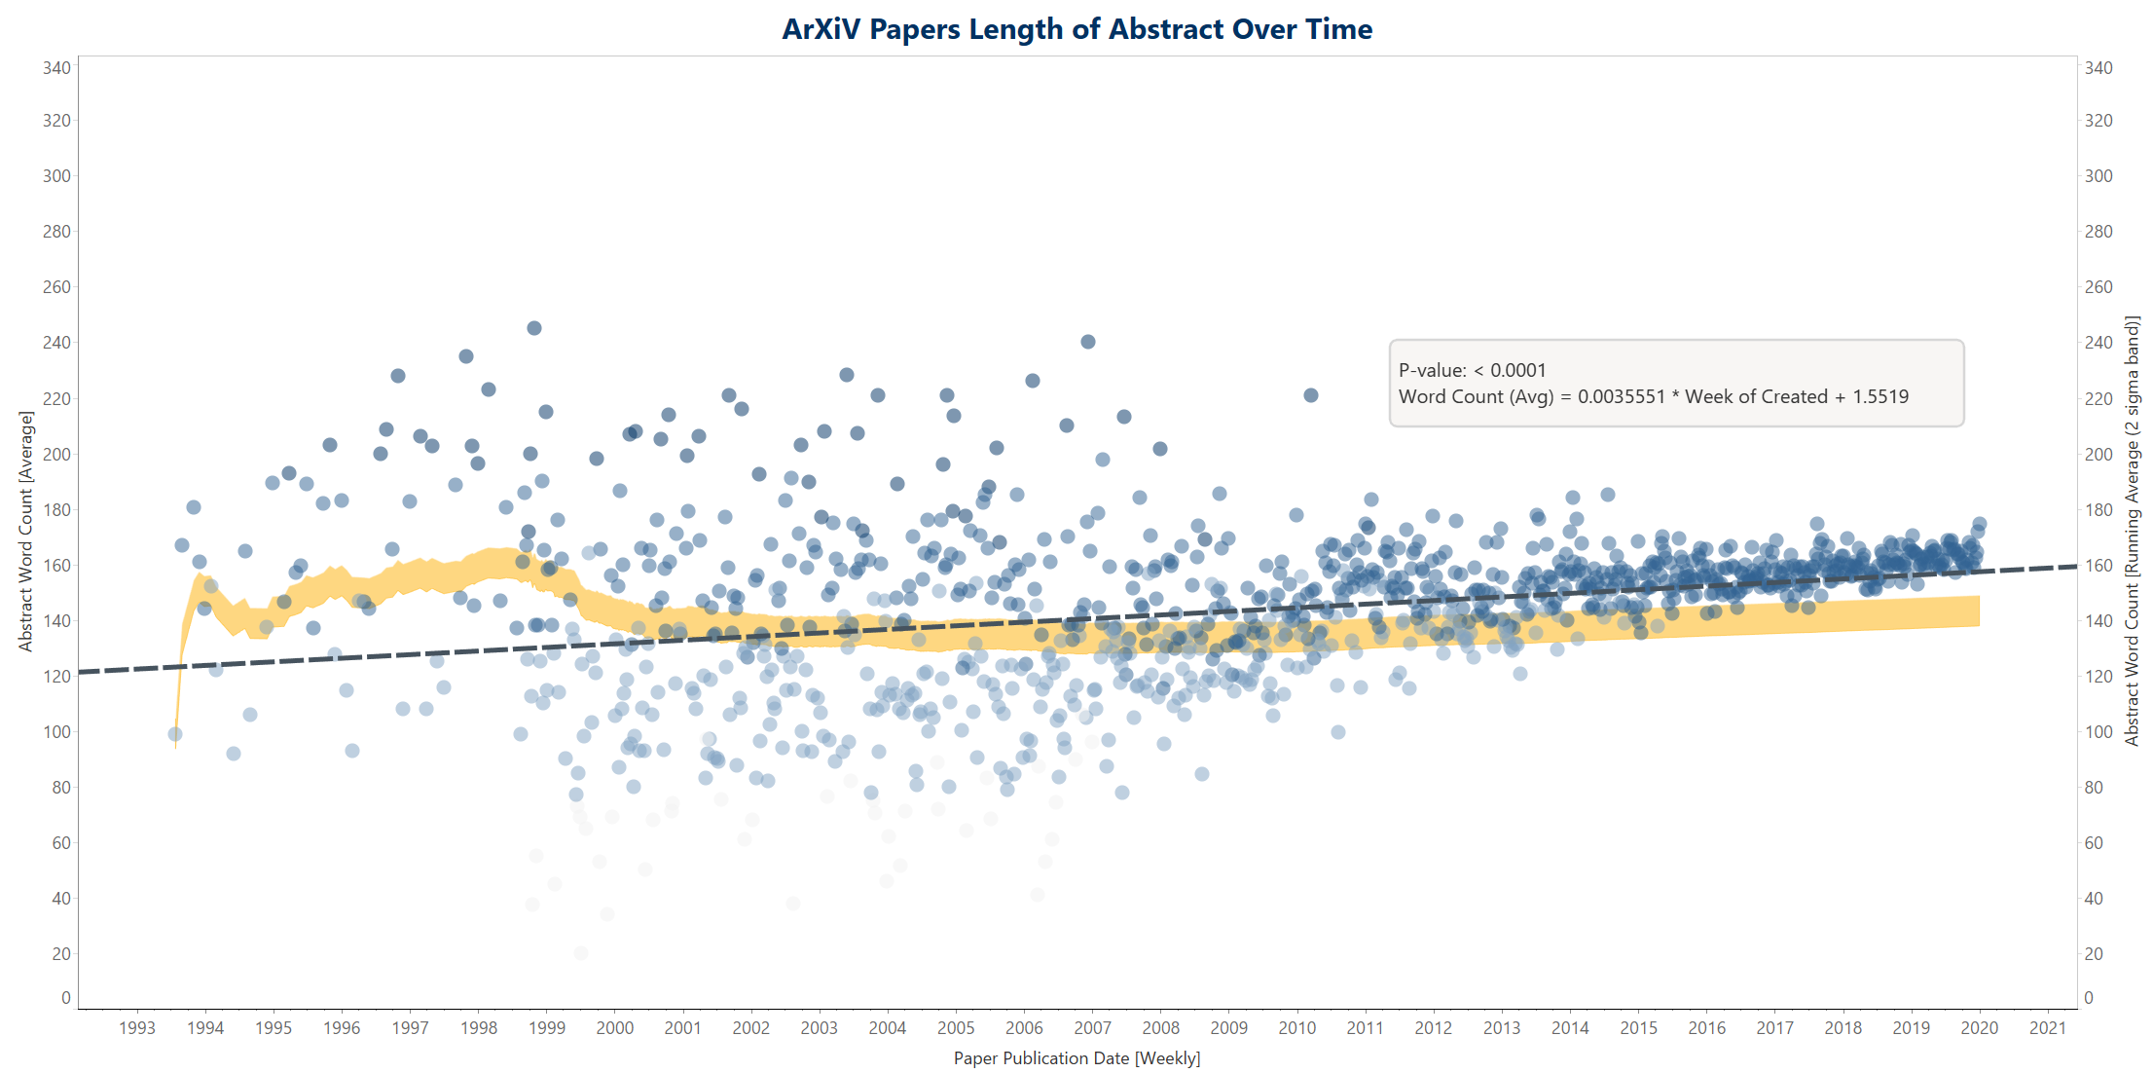
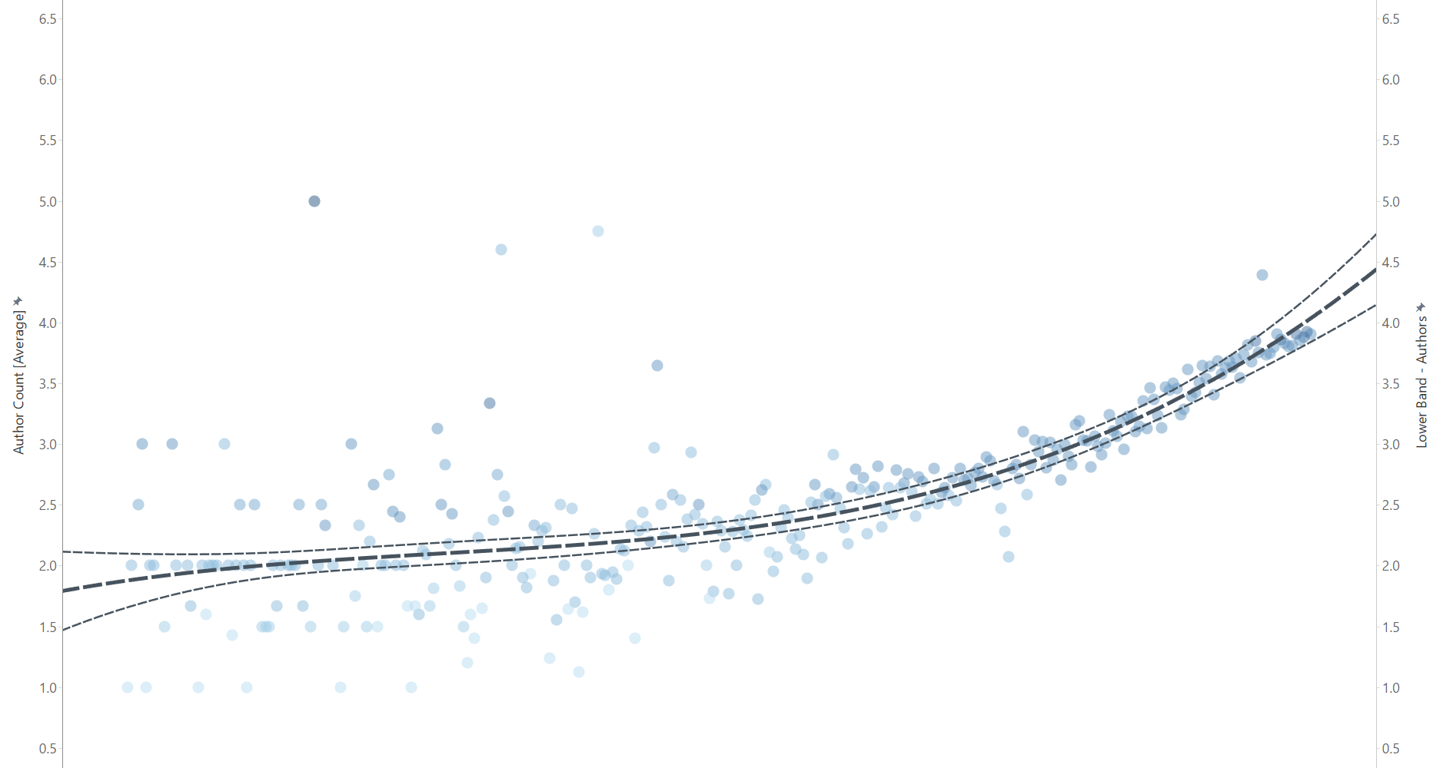
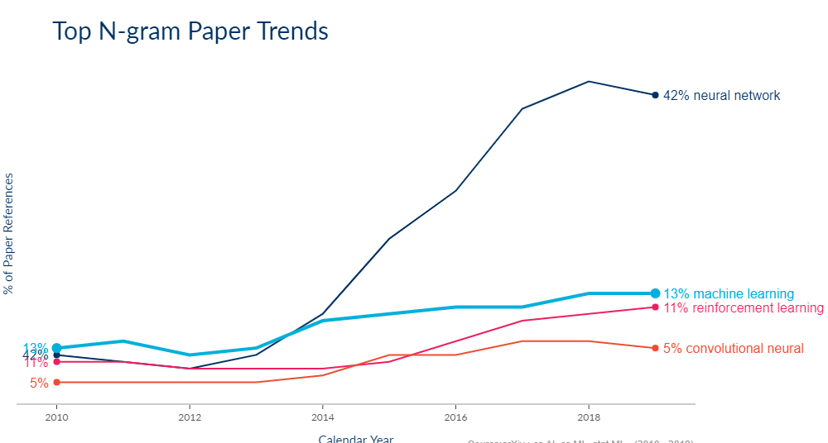
W209
Midterm Presentation
ARXIV
AI & ML Paper Analysis (1993 – 2019)

Slide 2
W209
Midterm Presentation
arXiv.org project overview
Cristopher Benge
Rahul Kulkarni
Anu Yadav
cris.benge@berkeley.edu
rauhl.kulkarni@berkeley.edu
anu.yadav@berkeley.edu
arXiv™ is a free distribution service and open archive for scholarly articles in the fields of physics, mathematics, computer science, quantitative biology, finance, statistics, electrical engineering and systems system, and economics. Our project aims to highlight AI/ML topic trends, paper submission behavior, and emerging areas of interest to students and researchers in the field of artificial intelligence and machine-learning – sourced entirely from arXiv’s 1.7M scholarly articles.
Download Here

Slide 3
W209
Midterm Presentation
arXiv AI/ML analysis Project Iteration
W209 Kick-Off
Project concept formation, data collection, GitHub repository organized.
Midterm
EDA completed, tool selection, hypothesis testing, modeling, visualization work.
Final Presentation
Key insights identified, testing complete, release v1.0 in repo, completed presentation.

Slide 4















W209
Midterm Presentation
arXiv AI/ML analysis
Development Pipeline Components
DATA EXPLORATION
VIZ FRAMEWORKS
ARXIV API
Notebook
Tableau Desktop
VS Code
Sand Dance
Power BI Desktop
STORAGE
DATA PROCESSING
arXiv repo
CSV
(processed)
HDF5
(raw categories)
DOCUMENTATION
RAW
(JSON)

Slide 5



W209
Midterm Presentation
arXiv AI/ML analysis
Solution Component Architecture
Source Data
Azure Components
User Access
Power BI Service
HDF5
POWER BI MOBILE
CSV
AZURE DATA SCIENCE VIRTUAL MACHINES
AZURE APP SERVICE
GitHub Gateway (Static)
RAW
Power BI Imported Data set
POWERBI.COM
File Store
Compute
Service Layer
Developer Access
Import Mode
POWER BI DESKTOP
TABLEAU DESKTOP
MISC. DEV TOOLS

Slide 6
W209
Midterm Presentation
arXiv AI/ML analysis
Validation Testing
Observe & Interview
Task-Based Evaluation
Basic Insights
Comparison Efficiency
Observe interaction with visualizations and interview target users
Task-oriented approach, focused on time-to insight
Evaluate effectiveness of study candidate to locate & understand
Evaluate effectiveness of study candidate to compare values
Our approach follows an informal usability study, focusing on evaluating the ability of study candidates to reach task-oriented insights, and the time spent to achieve basic understanding of data presented

Slide 7
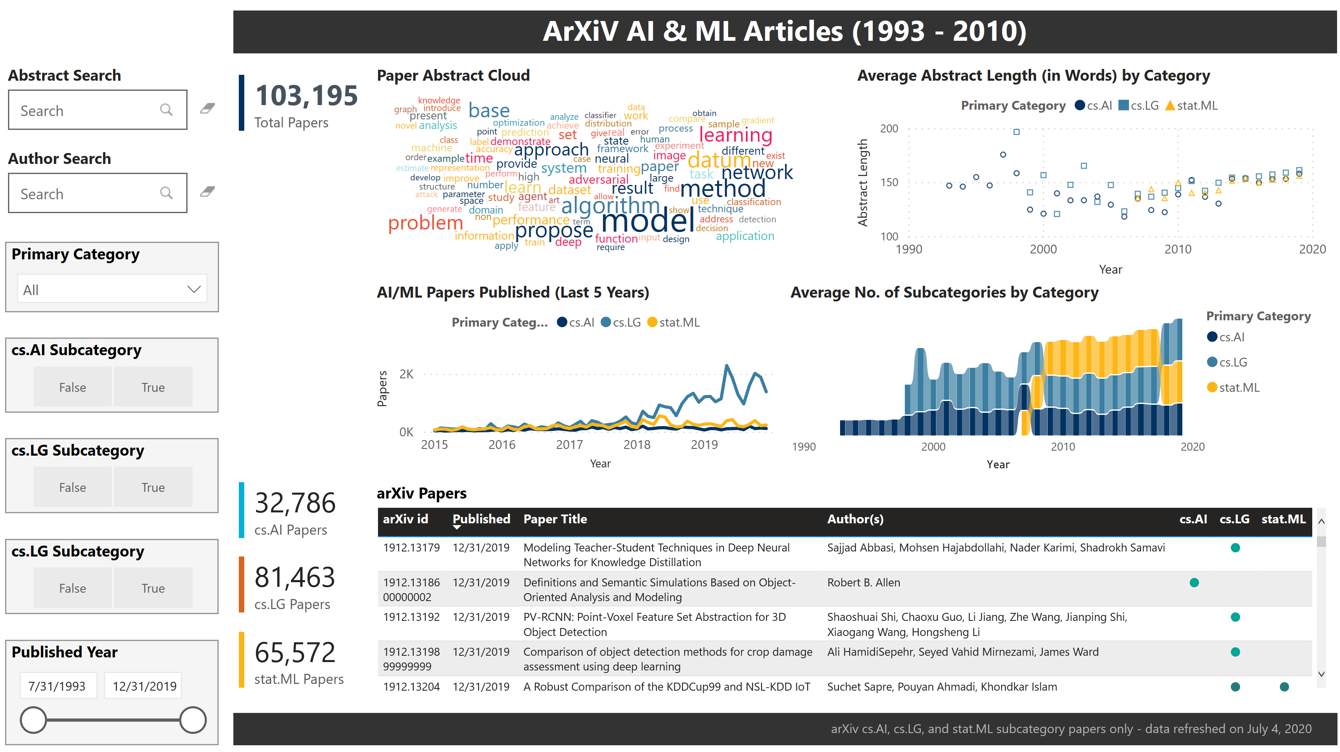
Midterm Presentation
W209
INSIGHTS in
cs.AI, cs.ML, stat.ML
RESEARCH (1993 – 2019)
Power BI service-hosted ArXiV AI & ML Articles dashboard drives insights in an interactive browser experience.
View Now
Instant access to arXiv’s impressive collection of artificial intelligence & machine learning papers.
Desktop experience is also available in repo!

Slide 8
W209
Midterm Presentation
THANKS
QUESTIONS?

